Slide 1

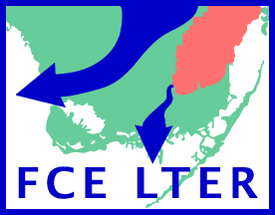
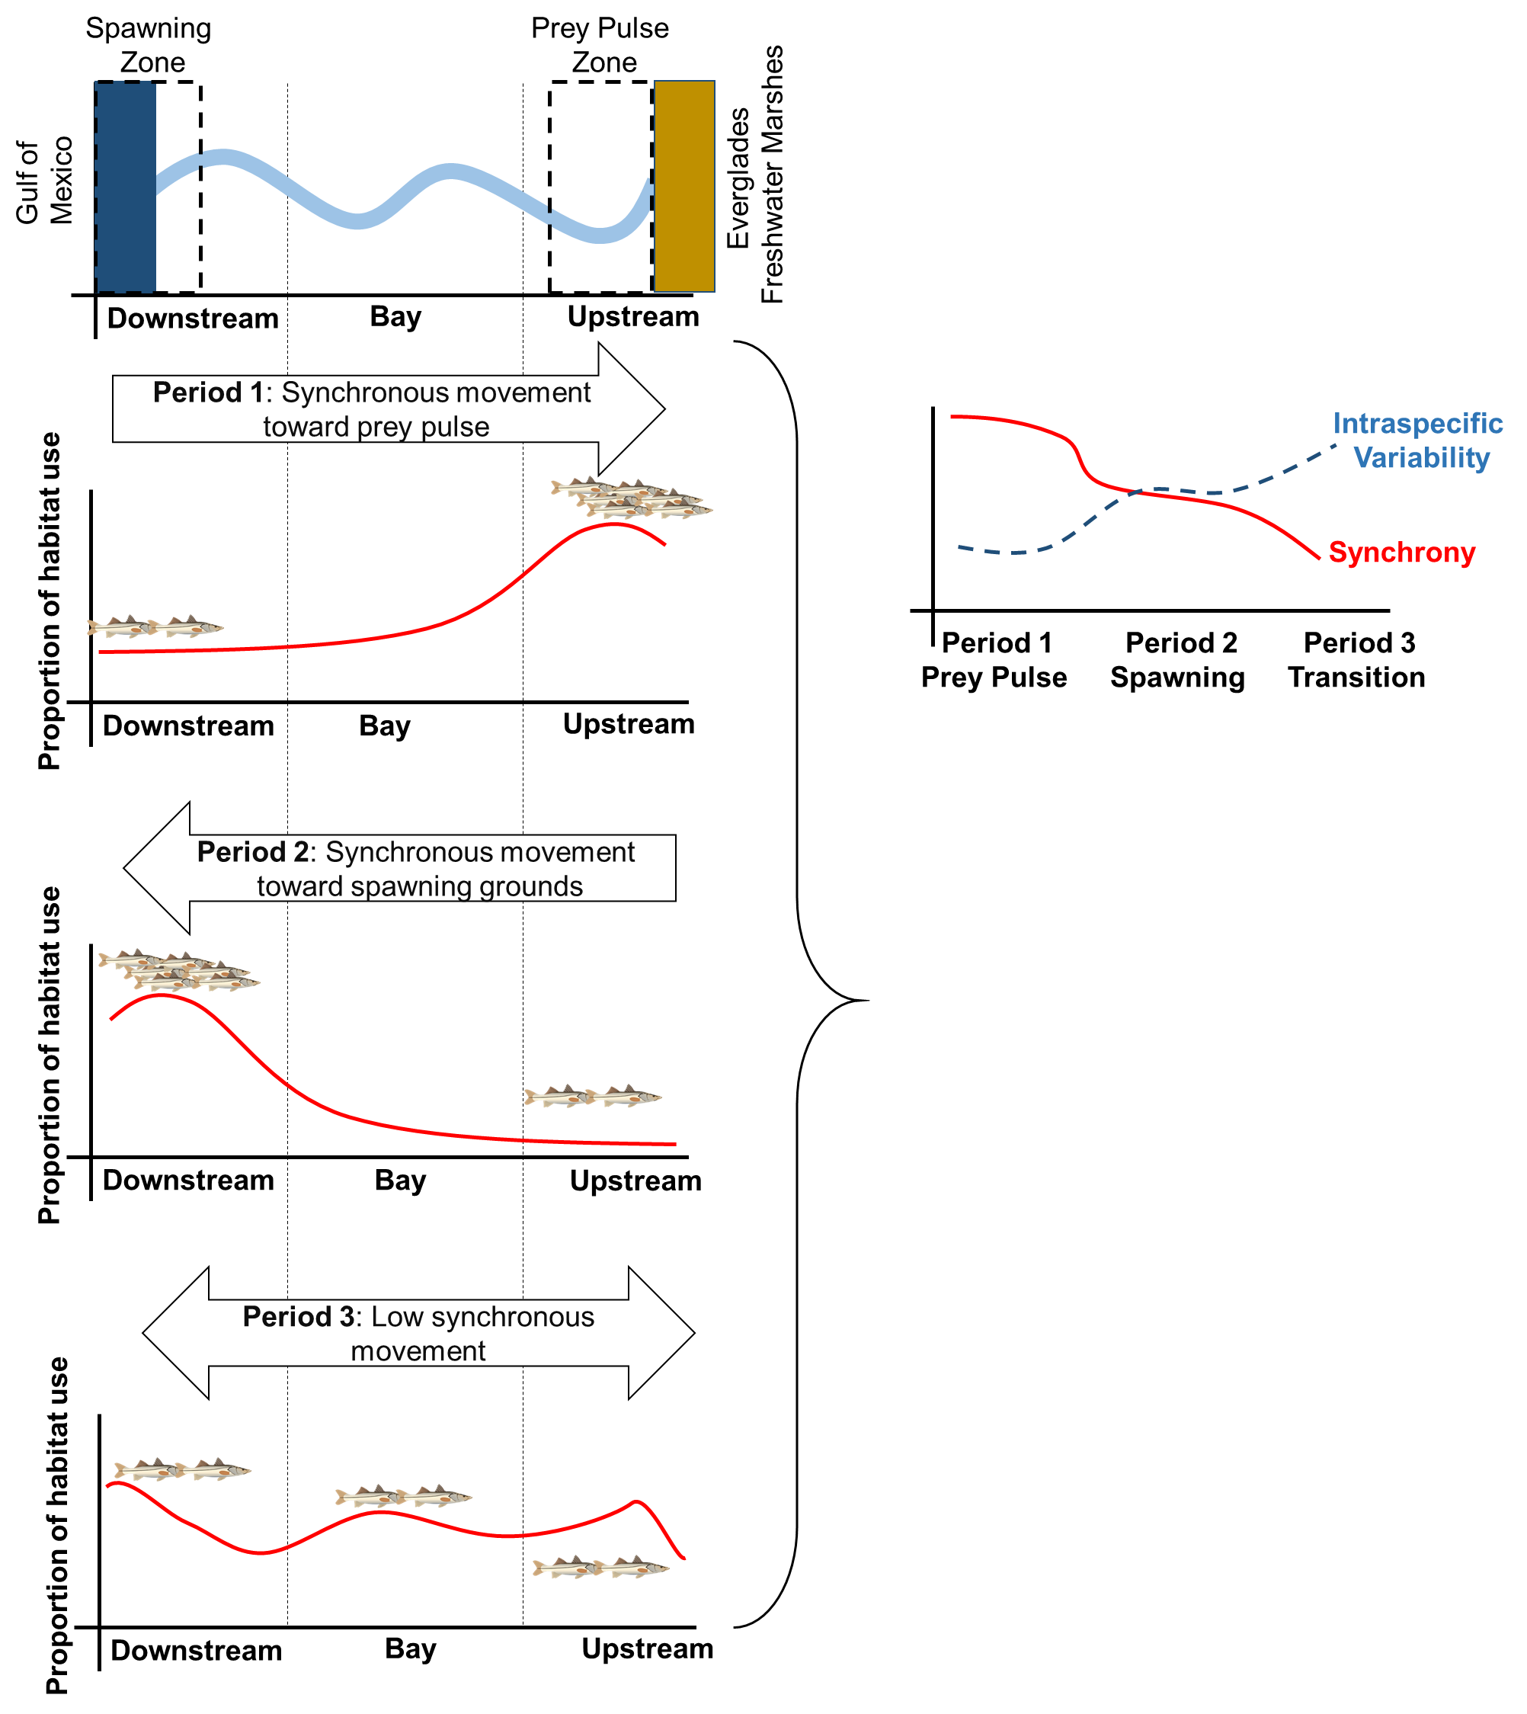
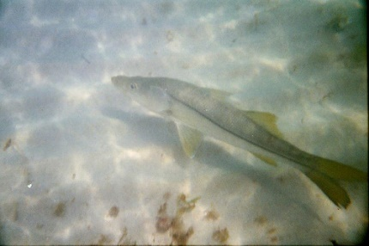
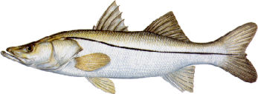
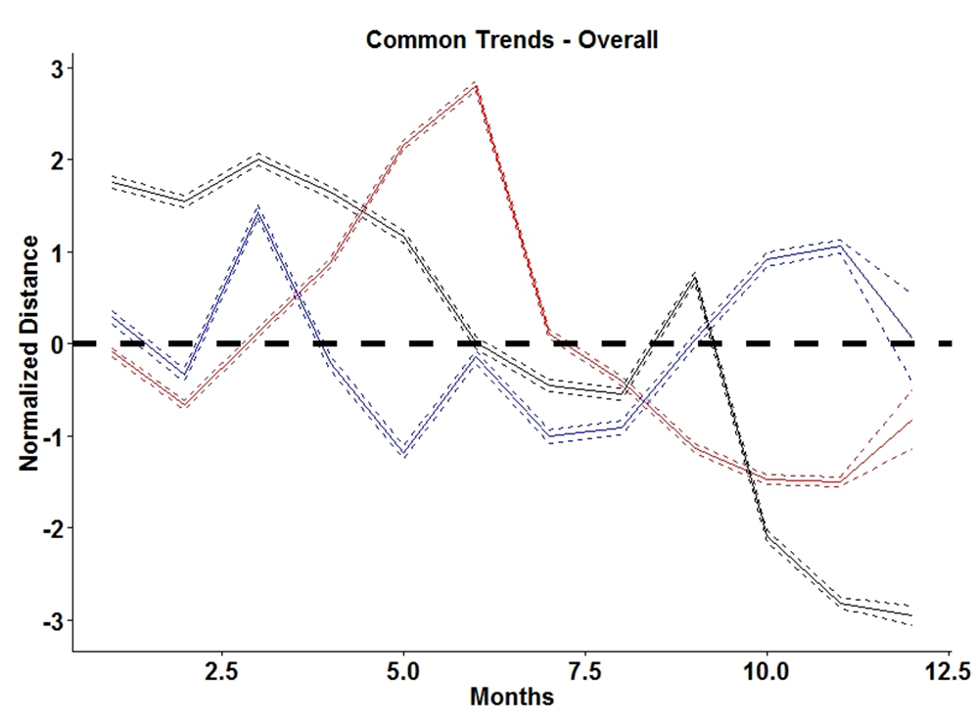
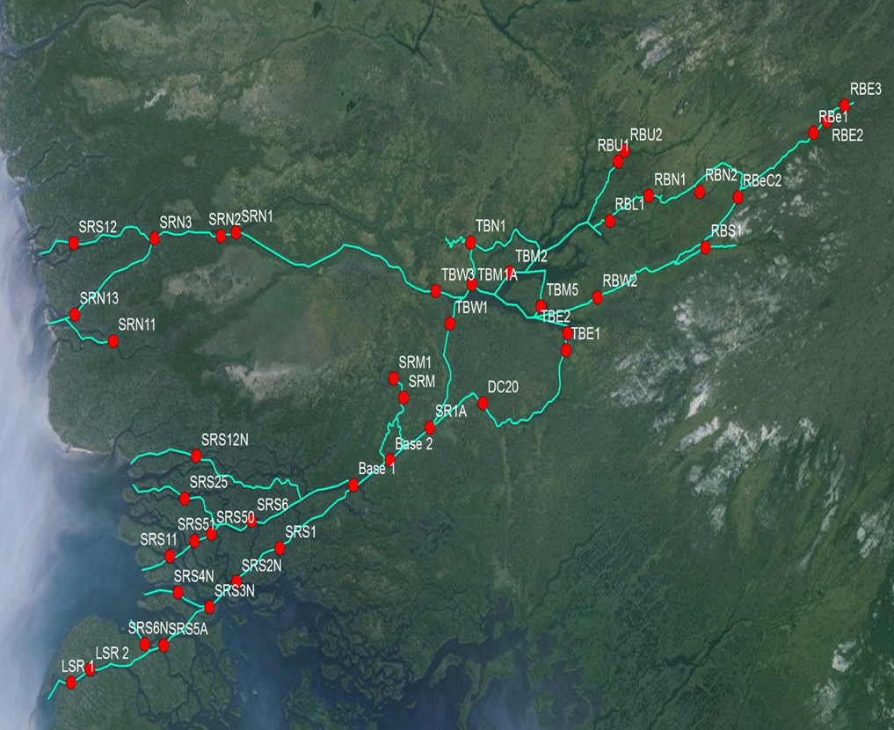
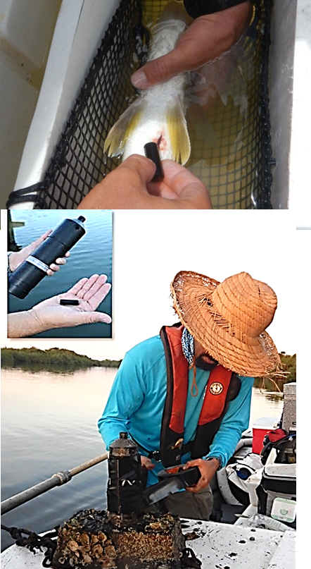
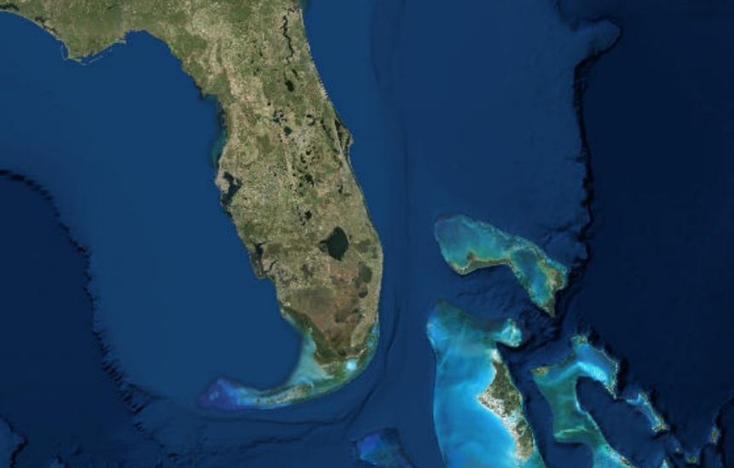
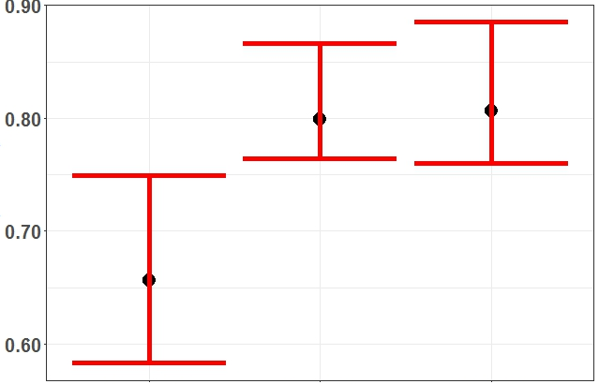
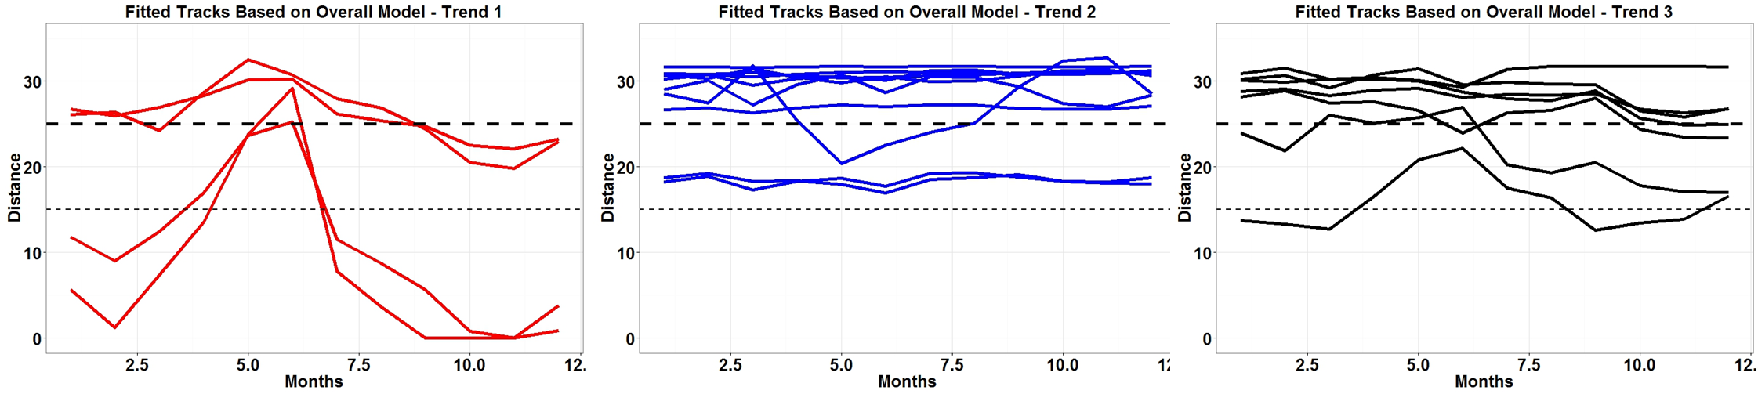
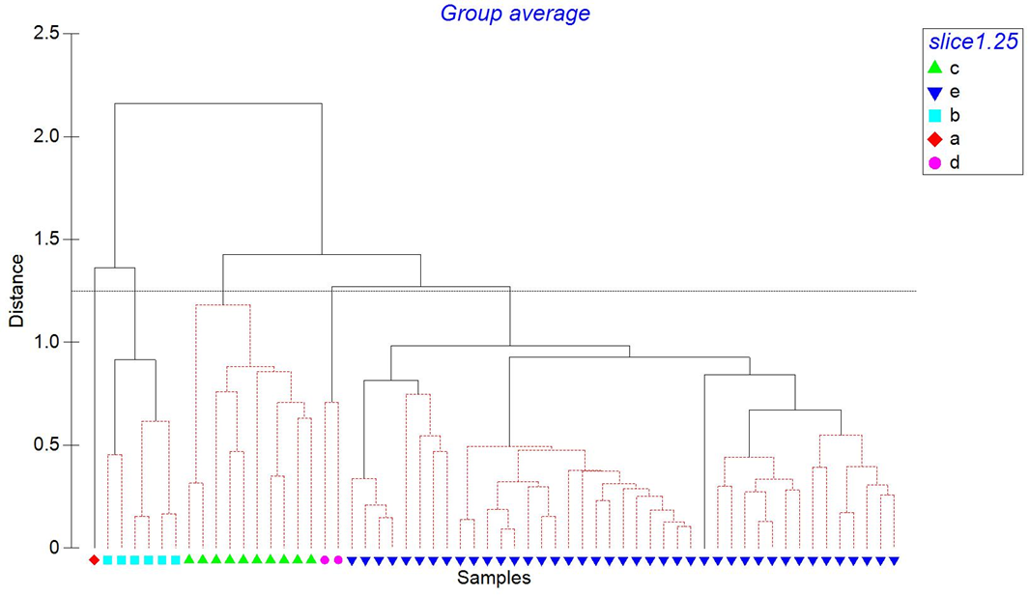
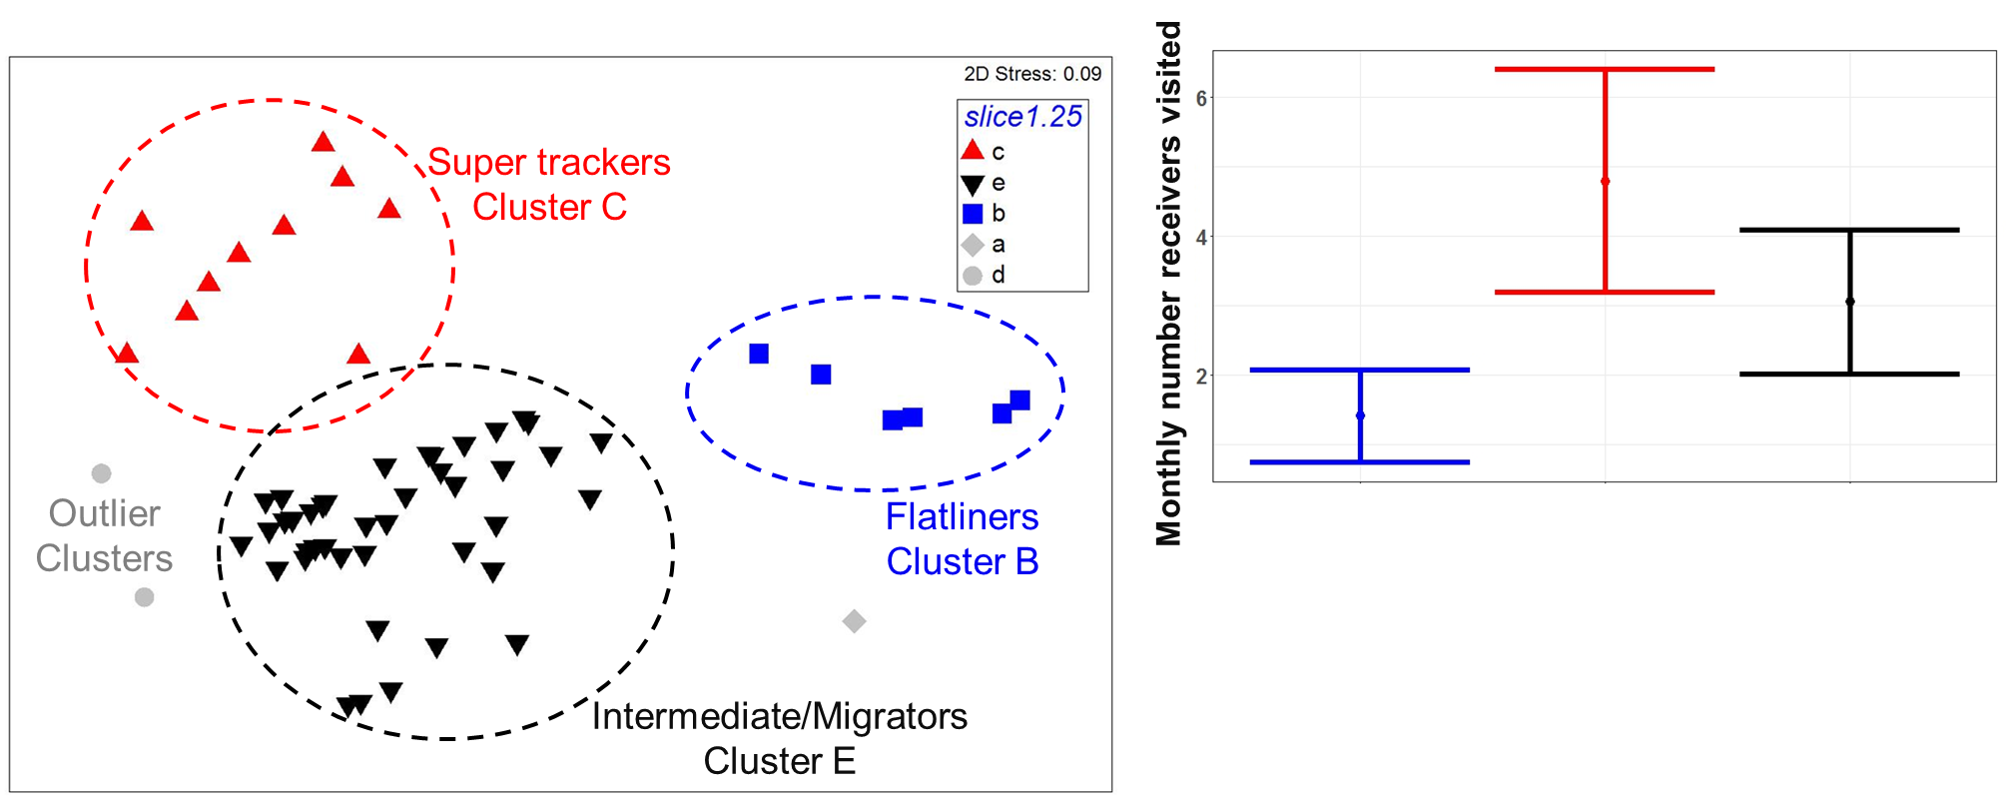
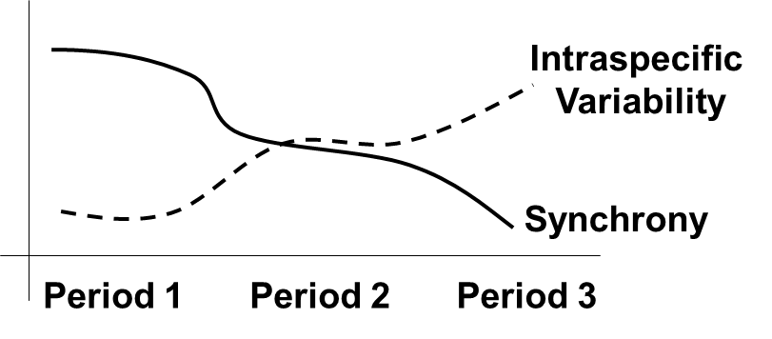



Synchrony vs intraspecific variability over time:
Snook movement in the Everglades
Rolando O. Santos^{1*}, Jennifer Rehage¹, and Ross Boucek²
¹Southeast Environmental Research Center and Dept. of Earth and Environment, Florida International University, Miami, FL, USA
²Florida Fish and Wildlife Research Institute, St Petersburg, FL, USA
*Corresponding Author – email: rsantosc@fiu.edu
1
Fig 4. Conceptual diagram of hypothesized synchrony periods
5
Background
Organisms can move in synchrony or manifest intraspecific movement patterns in response to environmental heterogeneity and in life history demands (e.g., foraging vs. spawning). Temporal forcing should drive some degree of synchrony in space. Whether a population behaves as a homogeneous or heterogeneous unit has important management and conservation implications
Results and Discussion (cont.)
II. Question 2
The best DFA model was explained with three underlying trends or tracks (Fig 6a).
We defined these three underlying trends as movement strategies (Fig 6a):
“Super trackers” – high movement across the three zones (Red – Trend 1)
“Flatliners” – high zone fidelity (Blue – Trend 2)
“Intermediate or migrators” – move across in a migration form (Black – Trend 3)
For each individual, we selected the trend that best explained their track across Shark River to illustrate individuals movements (Fig 6b). Even among these estimated trends, there still evidence of large individual variability as illustrated by the fitted trends in Fig 6b.
Using different measures of movement behavior (i.e., number of receivers visited) we also identified individuals that clustered within distinct movement strategies that supported the movement strategies definitions from the DFA results (Fig 7).
Objective
The objective of this study was to assess the degree of common snook (Centropomus undecimalis) (Fig 1) movement synchrony vs intraspecific variability in Shark River of the Everglades National Park (Florida, USA) using an acoustic telemetry approach (Fig 1). Common snook represents one of the most popular and lucrative fisheries in South Florida region. Based on previous studies, we hypothesized three periods of distinct patterns of snook synchronous movements (Fig 3). Specifically we asked:
Question 1: What is the degree of synchrony during the hypothesized periods of synchronous movement?
Question 2: If intraspecific variability is high during these periods (i.e., lack of synchrony), is there evidence of distinct movement strategies?
Period 1 – High Synchrony: Snook migrate to the upstream zone of Shark River to consume prey pulses that come from adjacent floodplains during peak dry season (March-April) = high synchrony and low intraspecific variability in movement and spatial distribution.
Period 2 – Intermediate Synchrony: Between May and October, individuals will migrate from upstream freshwater environments to brackish downstream environments for spawning = high to intermediate levels of synchrony and intraspecific variability
Period 3 – Low Synchrony: Expected to see low synchrony and high intraspecific variability between November and February due low and disperse prey resources within Shark River.
Fig 1. Common Snook (Centropomus undecimalis)
Fig 6a. Results of the dynamic factor analysis (DFA). Three underlying movement trends identified
Upstream
Fig 2. Shark River Acoustic Array
Transmitter
Bay
37 autonomous VR2W listening receivers
Downstream
Receiver
Fig 5. Intraspecific variability in spatial allocation measured with the E index
Fig 6b. Fitted tracks of individuals best explained by each trend identified by the DFA
Upstream
Florida (USA)
Bay
Shark River
Bahamas
Downstream
Fig 3. Analysis protocol to answer research questions
Intraspecific Variability (E index)
Fig 7. A multidimensional scaling (MDS) plot illustrating the clustering of individuals with distinct movement strategies, and summary plots of movement behavior within each cluster
Question 1:
Synchronous Periods?
E index
High
Question 2:
Movement Strategies?
DFA
&
Clustering
Low
✓
2
Period 1
High Synchrony
(Prey Pulse)
Period 2
Intermediate Synchrony
(Spawning)
Period 2
Low Synchrony
(Transition)
Materials and Methods
I. Study site and acoustic array
We used the Shark River Acoustic Array, a component of the Everglades Long Term Ecological Research, to track movement and distribution patterns of snook individuals (Fig 2).
Sampling and tagging
Selected individuals between 45-86 cm standard length were tagged with surgically fitted Vemco V16 or V13 transmitter. We only assessed tagged individuals that have a minimum of 90 days of continuous detection. Different individuals movement tracks where considered across a period of 4 years (2012-2015) (N = 60 individuals).
III. Assessment of movement and distribution patterns
A series of analyses were implemented to assess the research questions (Fig 3):
Question 1: E index (i.e., using Emc function of the RInSp R package) was used to determine intraspecific variability between the hypothesized periods.
Questiont 2: Dynamic factor analysis (DFA) and clustering analysis was used to identify distinct movement strategies
Cluster C
Cluster B
Cluster E
Flatliners – Cluster B: low number (and variance) of receivers visited
Intermediate – Cluster E: Intermediate number and low variance of receiver visited
Super trackers – Cluster C: High number and variance of receiver visited
Results and Discussion
Question 1
- The intraspecific variability of habitat use quantified with the E index was consistently high across all periods (i.e., E index 0.6-0.9)
(Fig 5)
Thus, spatial synchrony is more limited than expected and is largely overwhelmed by individual variation.
However, the intraspecific variability within Period 1 was significantly lower than the other periods (i.e., not overlapping 95 % confident levels estimated using a bootstrapping routine) in accordance with our expectation of higher habitat use towards upstream habitats where prey pulses occurred during this period (Fig 5).
6
Conclusion
Based on the snook individuals we assess using acoustic telemetry, we can conclude that synchronous movements of snook population in Shark River is limited, and characterized by a heterogeneous collection of movement strategies
Our next step is to assess how environmental factors influence the temporal dynamics of movement strategies to emphasize the role of animal behavior in mediating the response of organisms to changing conditions.
Acknowledgement

